Slide 1
Object Granularity

Slide 2
Object Granularity
Objects can vary tremendously in size and number. They can represent everything down to the hardware or all the way up to entire applications
While scope describes the breadth of objects, granularity describes the depth.
Design Patterns help to determine appropriate object granularity.
There is often trade offs in object granularity when trying to balance different aspects (performance, reusability, complexity etc)

Slide 3
Design pattern examples
Facade pattern describes how to represent complete subsystems as objects.
Flyweight pattern describes how to support huge numbers of objects at the finest granularities.
Abstract Factory and Builder yield objects whose only responsibilities are creating other objects.
Visitor and Command yield objects whose only responsibilities are to implement a request on another object or group of objects.

Slide 4
The granularity of data refers to the fineness with which data fields are sub-divided. For example, a postal address can be recorded, with low granularity, as a single field:
address = 200 2nd Ave. South #358, St. Petersburg, FL 33701-4313 USA
or with high granularity, as multiple fields:
street address = 200 2nd Ave. South #358
city = St. Petersburg
postal code = FL 33701-4313
country = USA
or even higher granularity:
street number = 200
street = 2nd Ave. South #358
city = St. Petersburg
postal code state = FL
postal-code-first-part = 33701
postal-code-second-part = 4313
country = USA

Slide 5
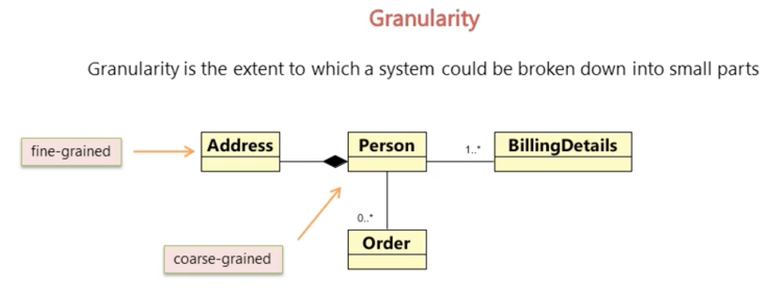

Slide 6
